Slide 1
Introduction to Ansible

Slide 2
Introduction to Ansible
Ansible Configuration
Ansible Inventory
Ansible Variables
Ansible Facts

Slide 3
Introduction to Ansible
Ansible Playbooks
Playbooks Verification
Ansible Conditionals
Ansible Loops

Slide 4
Introduction to Ansible
Ansible Modules
Ansible Plugins
Ansible Handlers
Ansible Roles
Ansible Templates

Slide 5
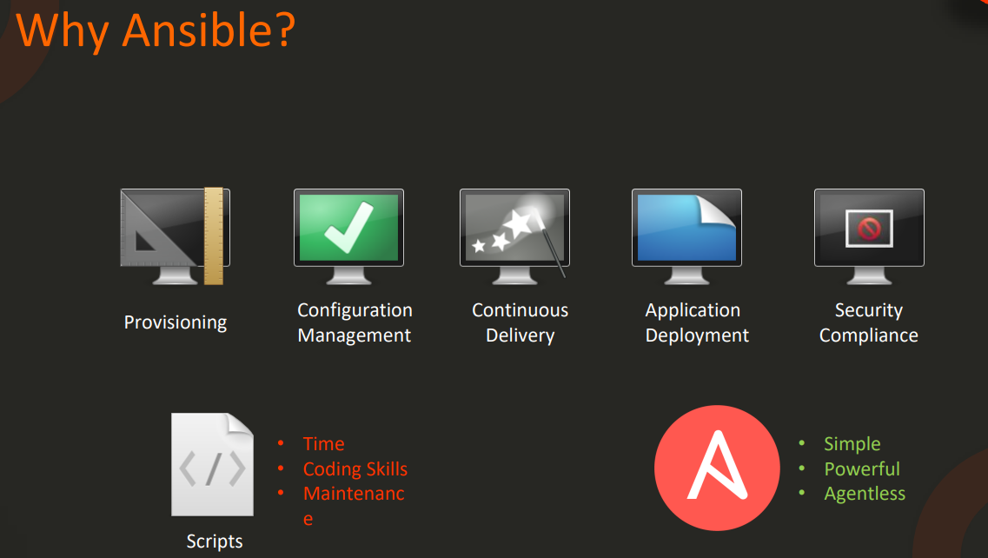
Ansible Introduction

Slide 6
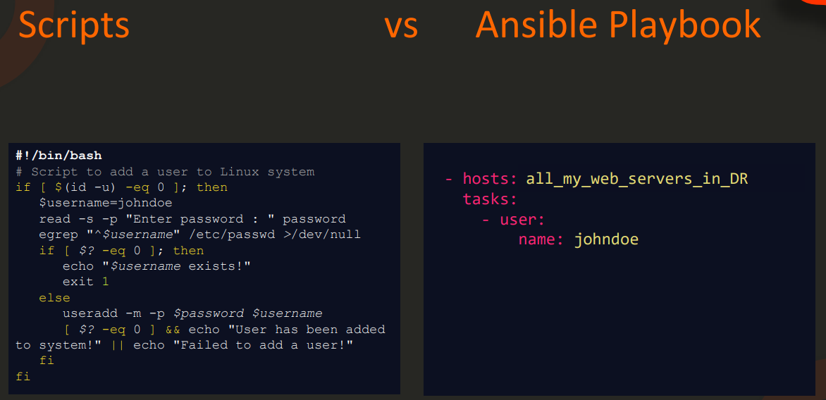
Ansible Introduction

Slide 7
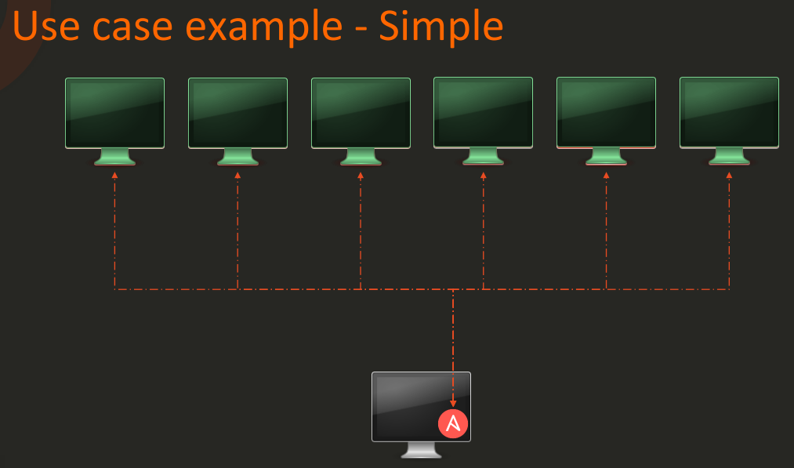
Ansible Introduction

Slide 8
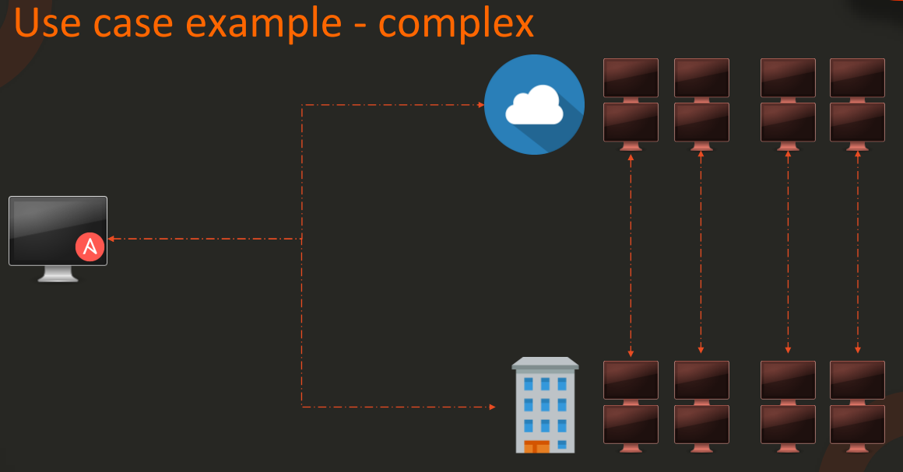
Ansible Introduction

Slide 9
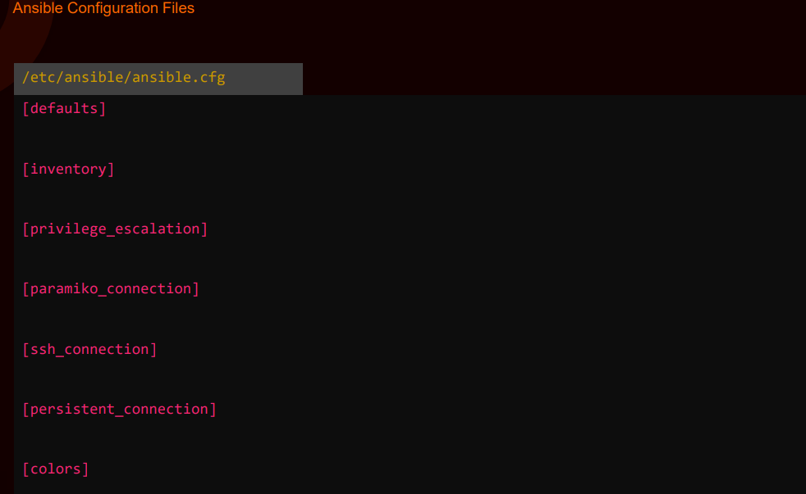
Ansible Configuration Introduction

Slide 10
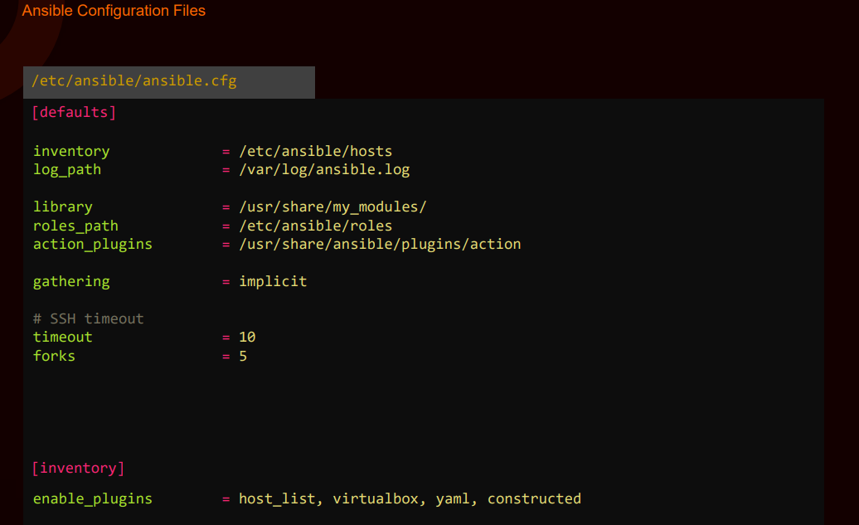
Ansible Configuration Introduction

Slide 11
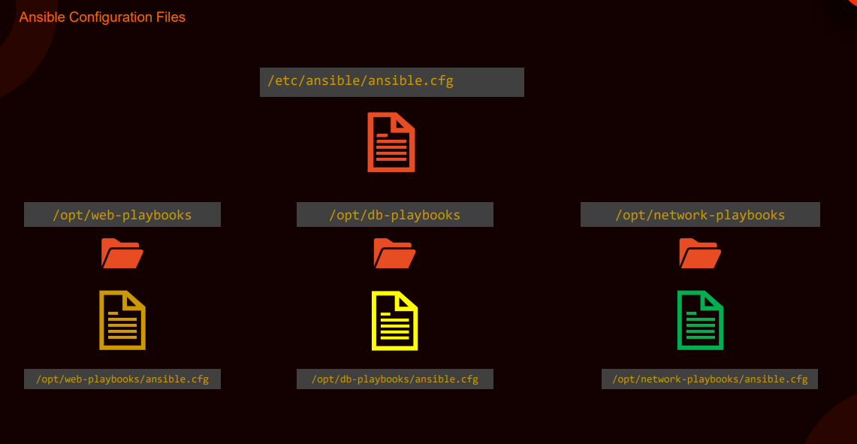
Ansible Configuration Introduction

Slide 12
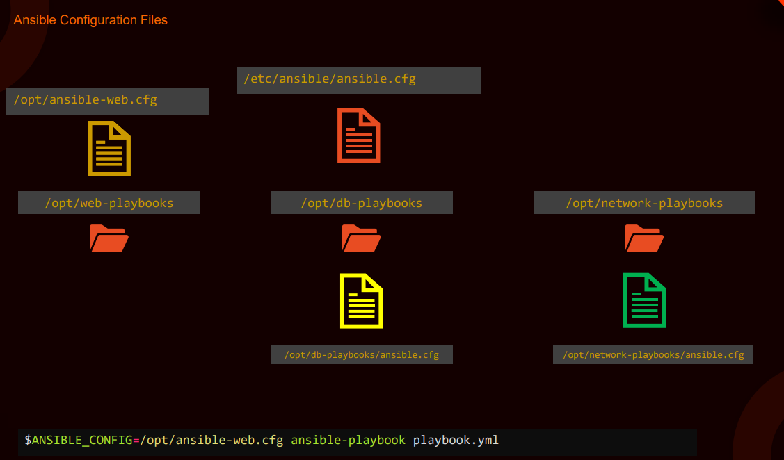
Ansible Configuration Introduction

Slide 13
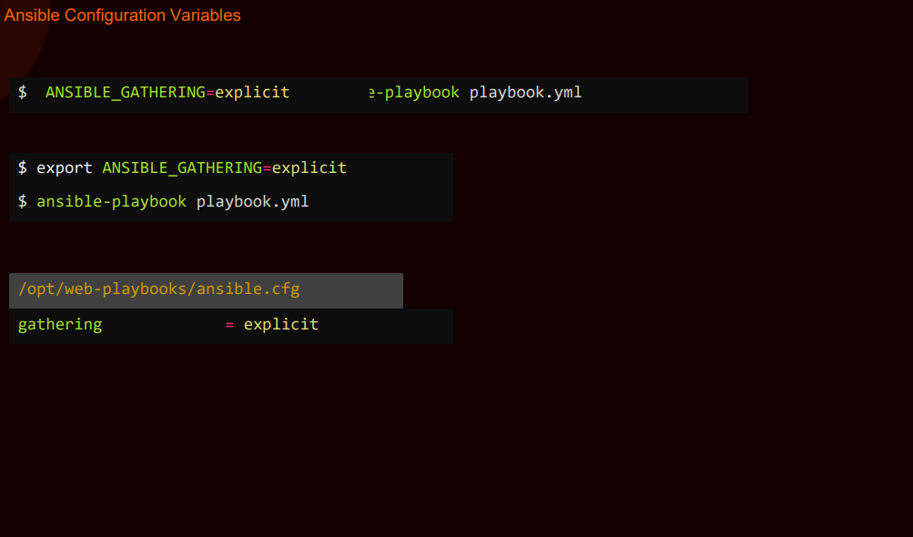
Ansible Configuration Introduction

Slide 14
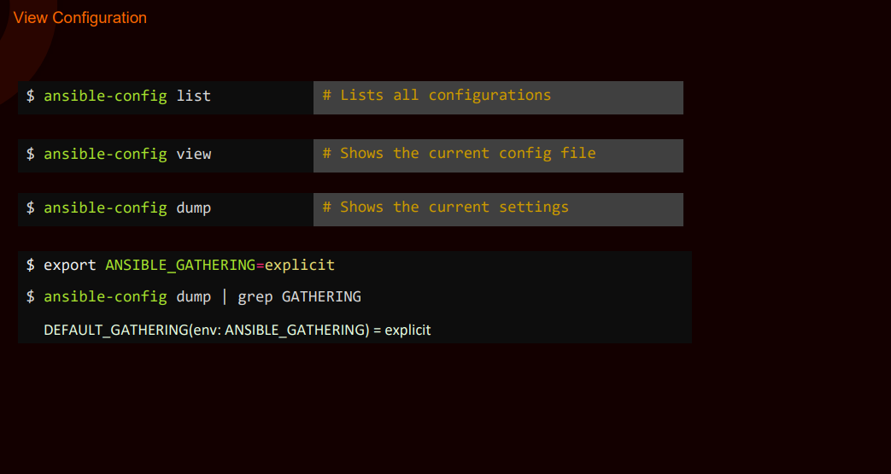
Ansible Configuration Introduction

Slide 15
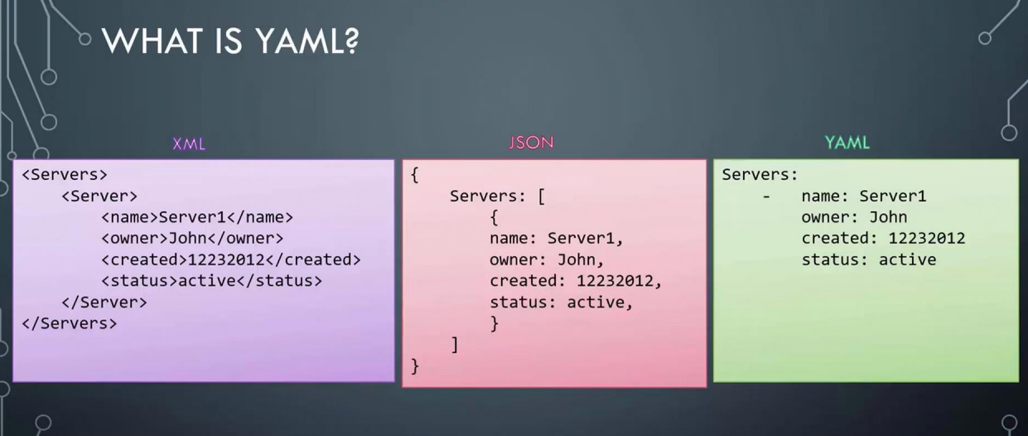
Introduction to YAML

Slide 16
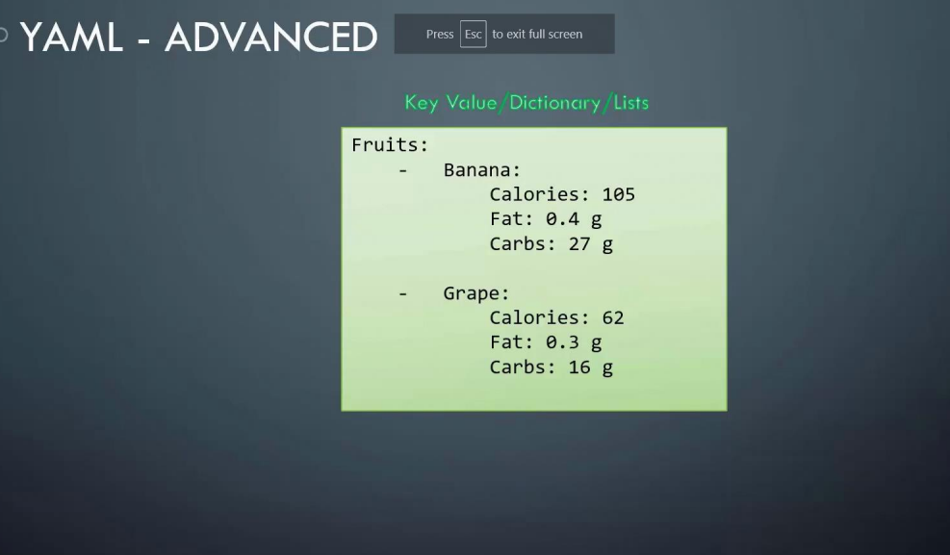
Introduction to YAML

Slide 17
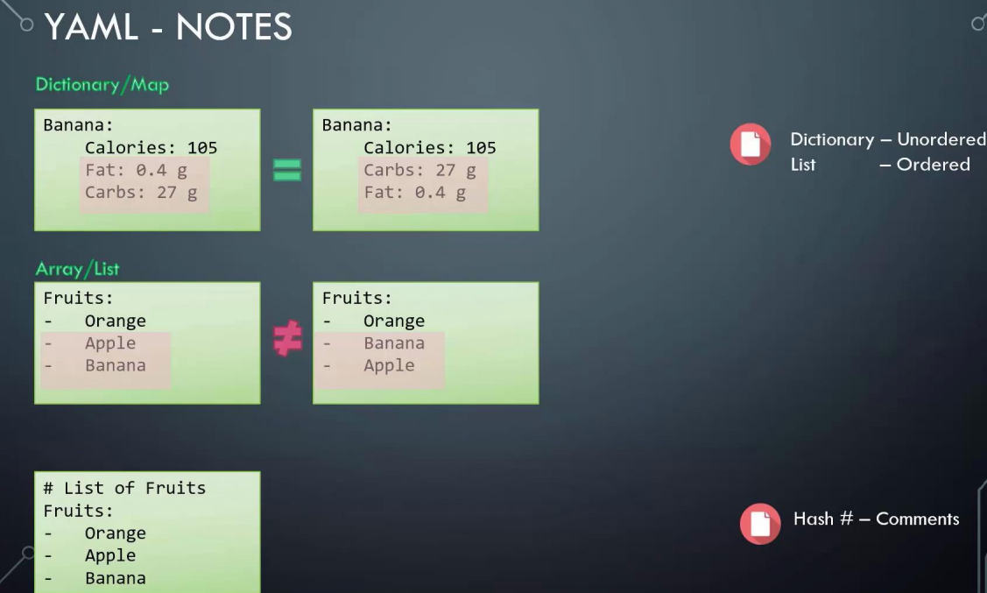
Introduction to YAML

Slide 18
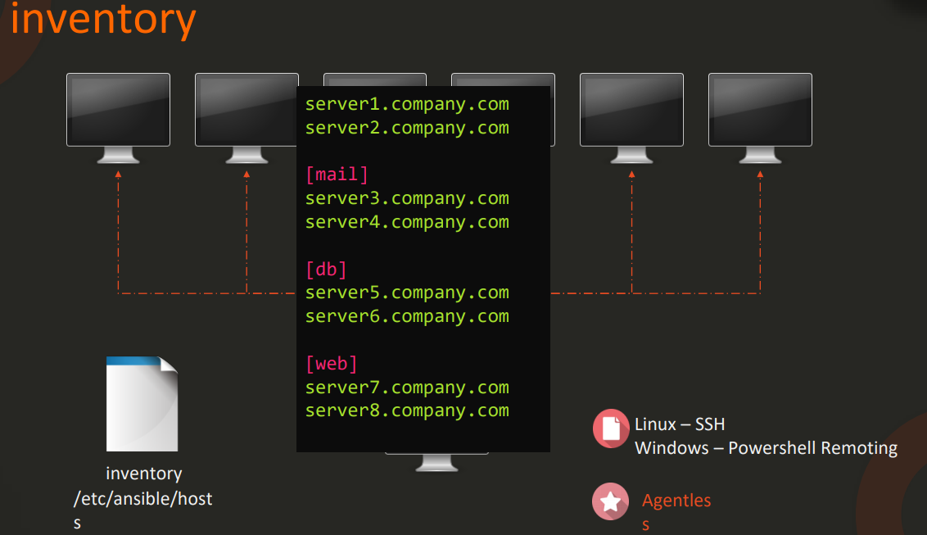
Ansible Inventory

Slide 19
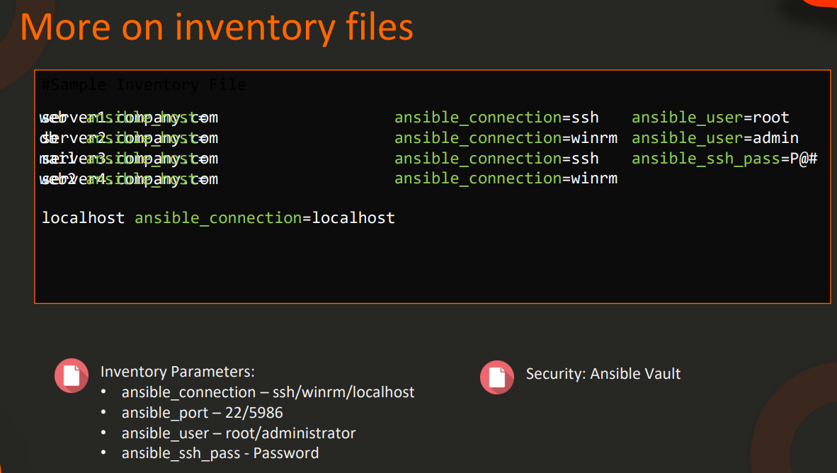
Ansible Inventory

Slide 20
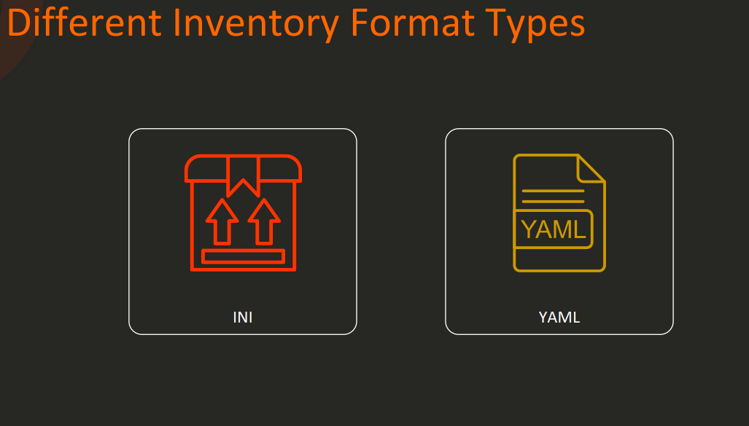
Ansible Inventory Formats

Slide 21
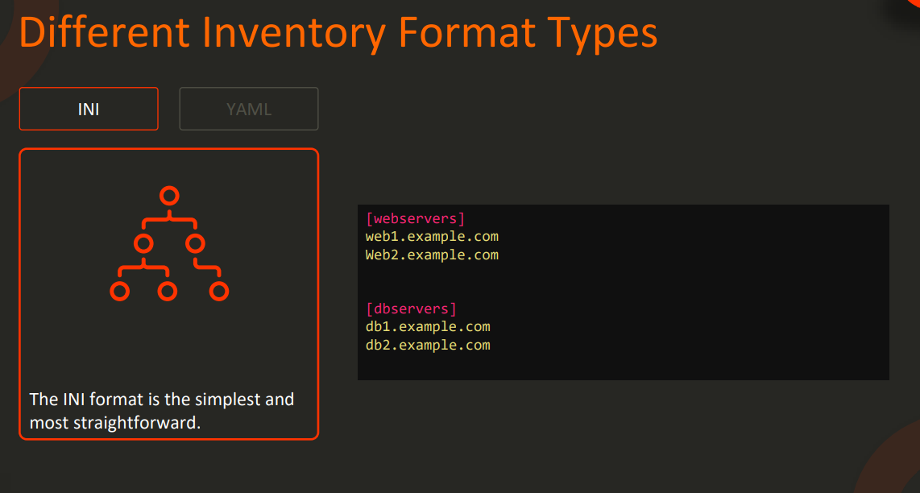
Ansible Inventory Formats

Slide 22
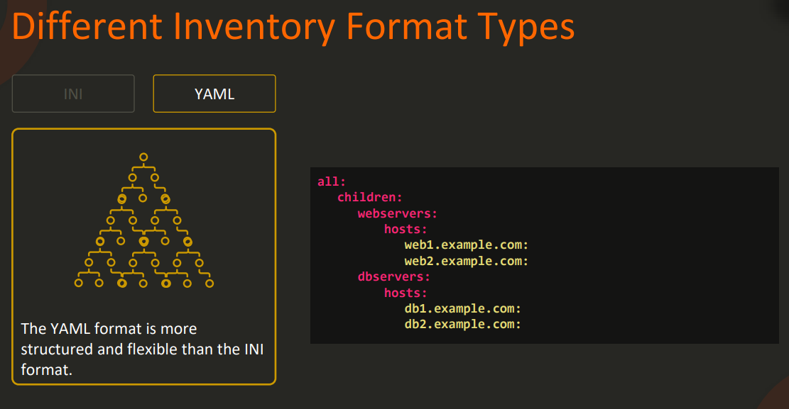
Ansible Inventory Formats

Slide 23
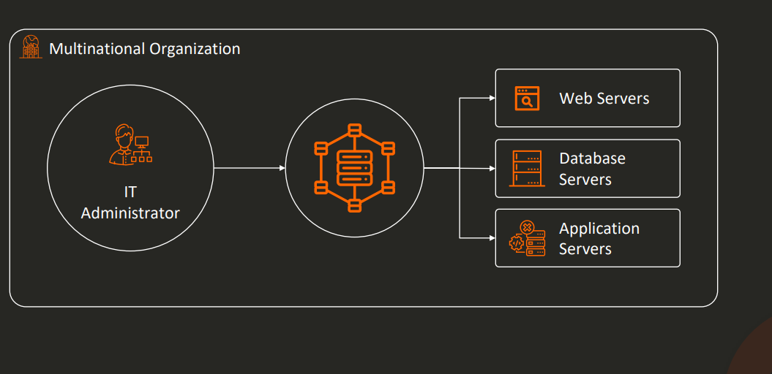
Grouping and Parent-Child Relations

Slide 24
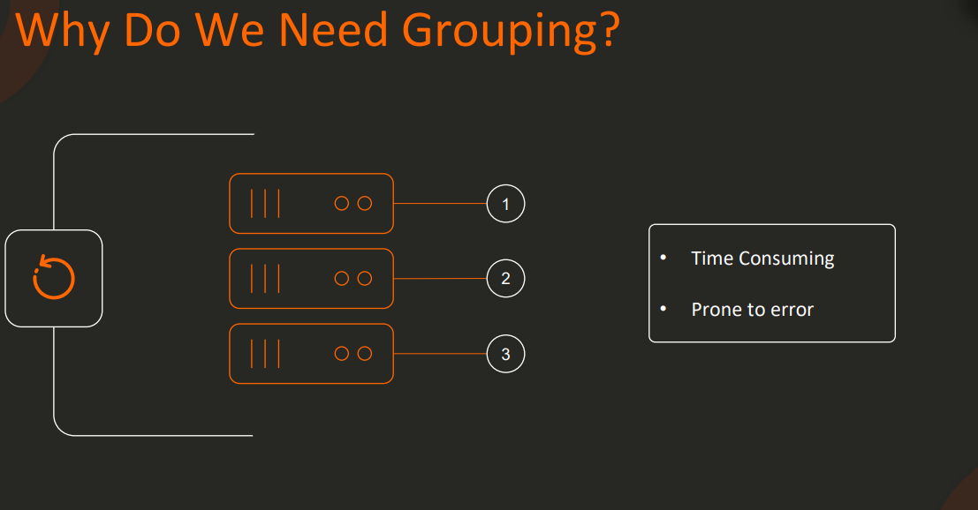
Grouping and Parent-Child Relations

Slide 25
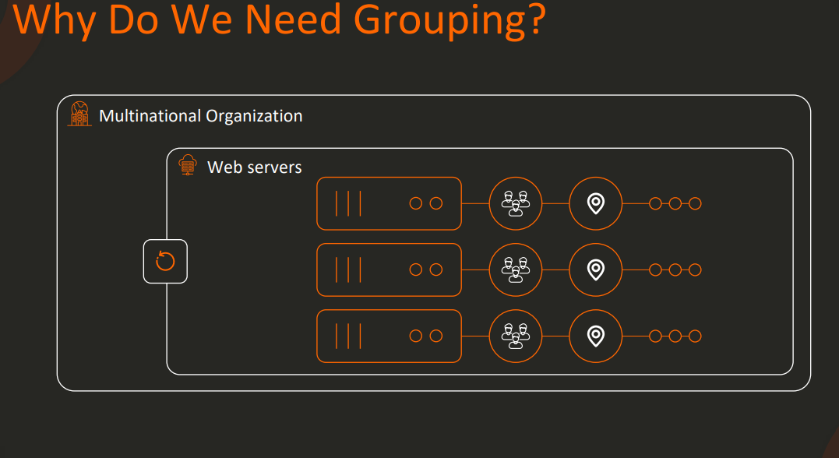
Grouping and Parent-Child Relations

Slide 26
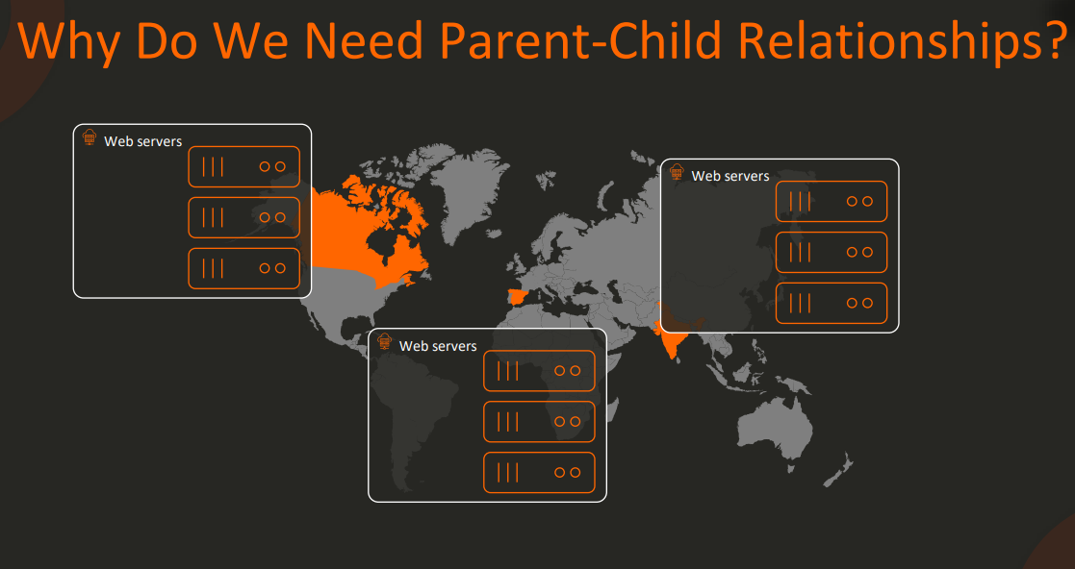
Grouping and Parent-Child Relations

Slide 27
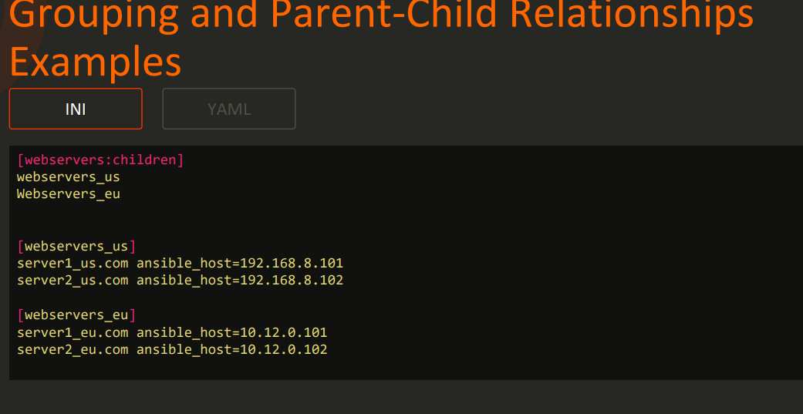
Grouping and Parent-Child Relations

Slide 28
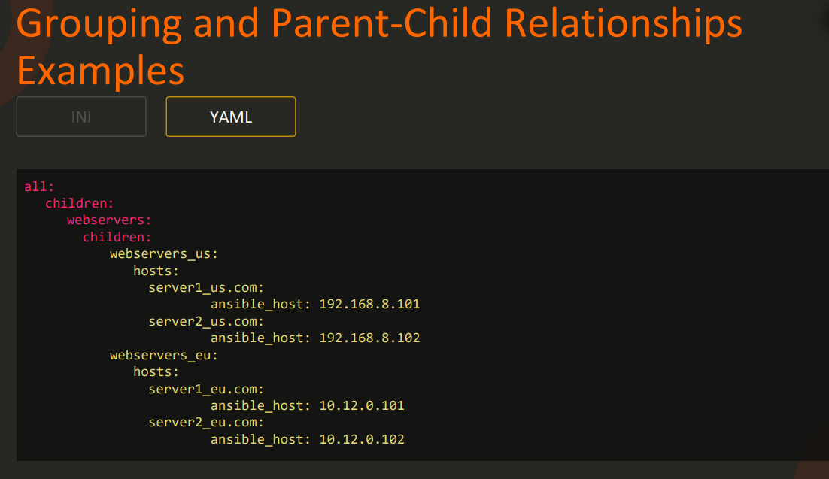
Grouping and Parent-Child Relations

Slide 29
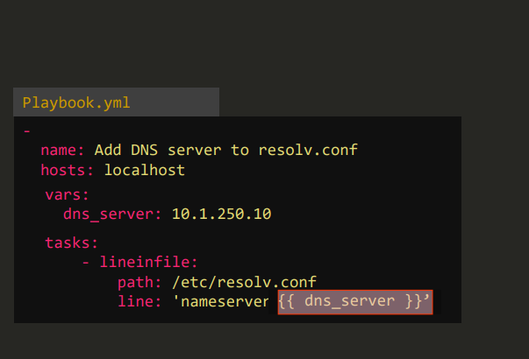
Ansible Variables

Slide 30
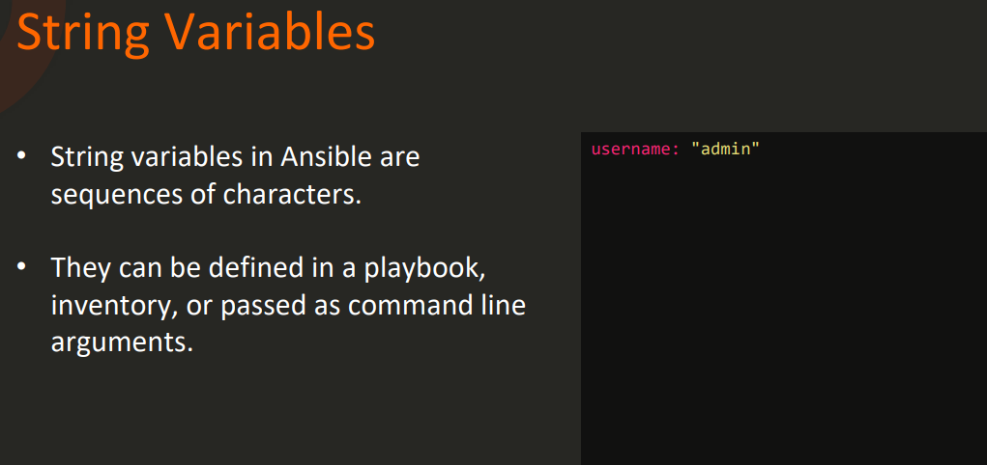
Ansible Variables - Types

Slide 31
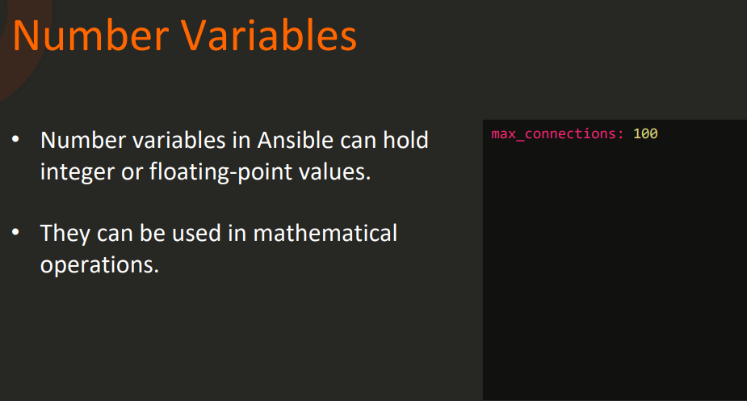
Ansible Variables - Types

Slide 32
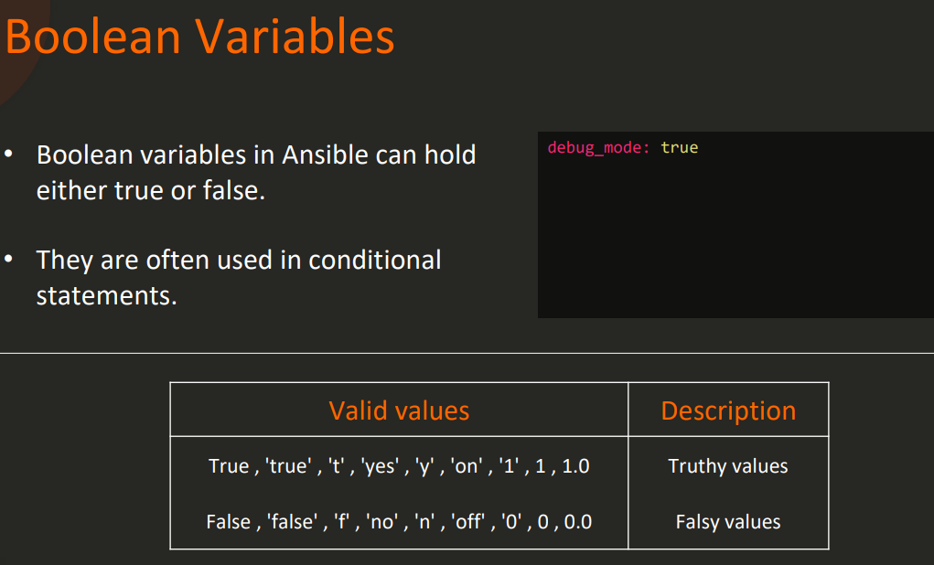
Ansible Variables - Types

Slide 33
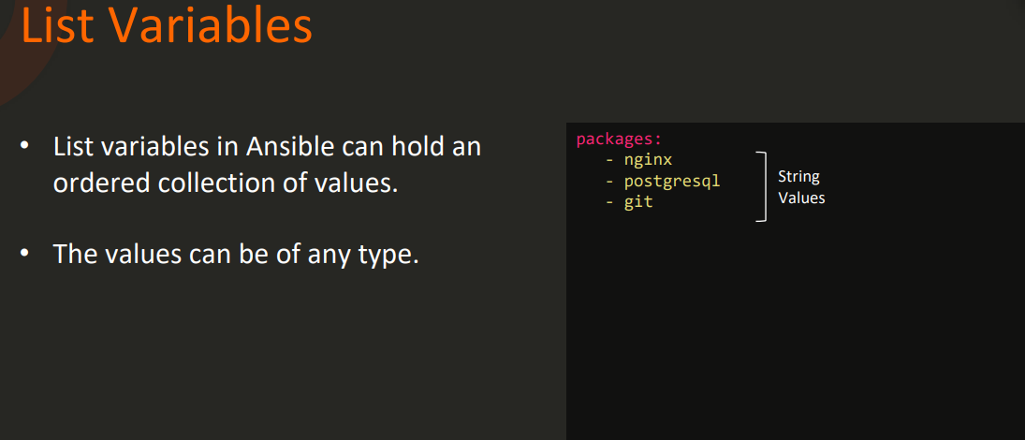
Ansible Variables - Types

Slide 34
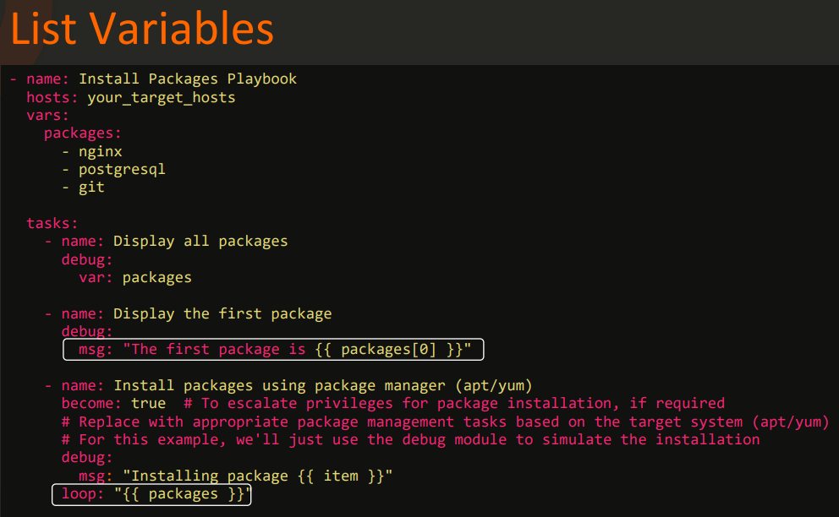
Ansible Variables - Types

Slide 35
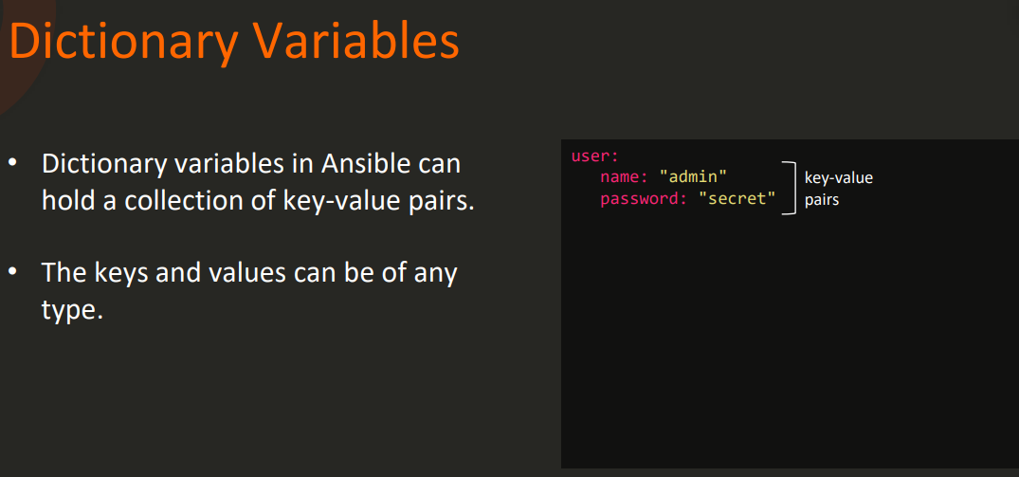
Ansible Variables - Types

Slide 36
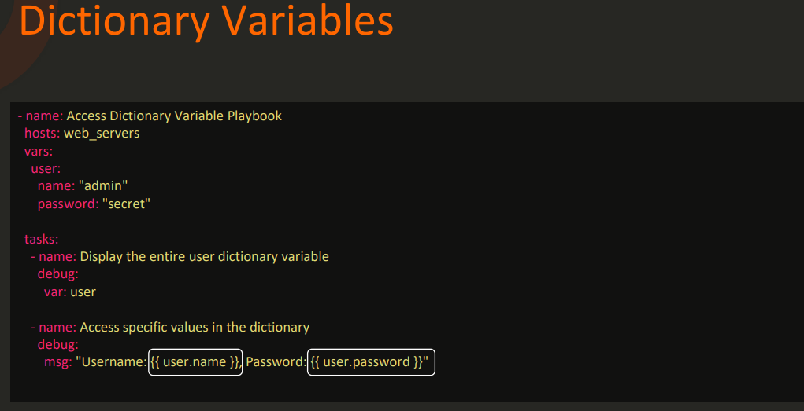
Ansible Variables - Types

Slide 37
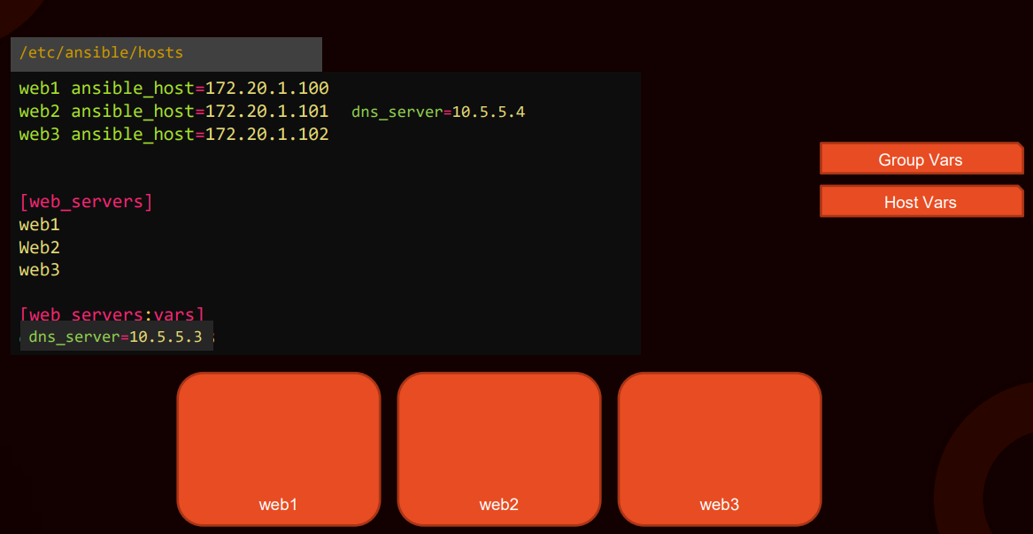
Ansible Variables - Precedence

Slide 38
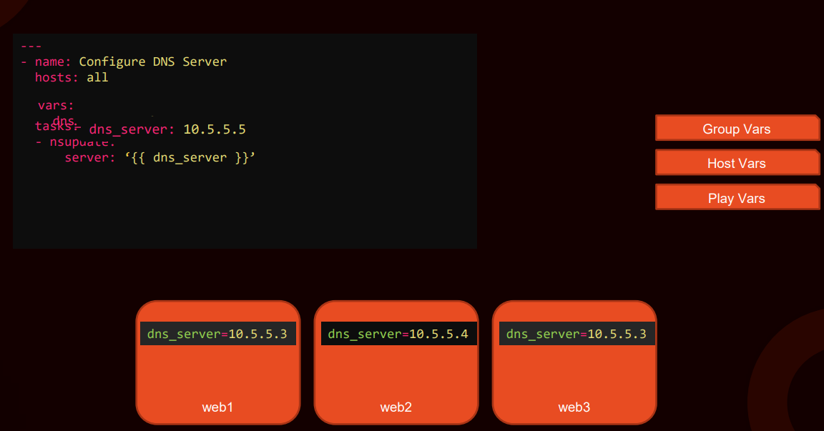
Ansible Variables - Precedence

Slide 39
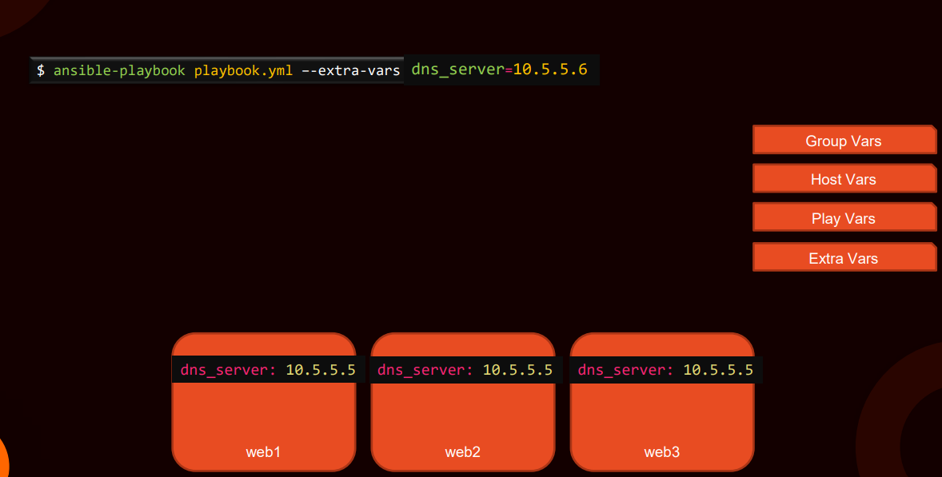
Ansible Variables - Precedence

Slide 40
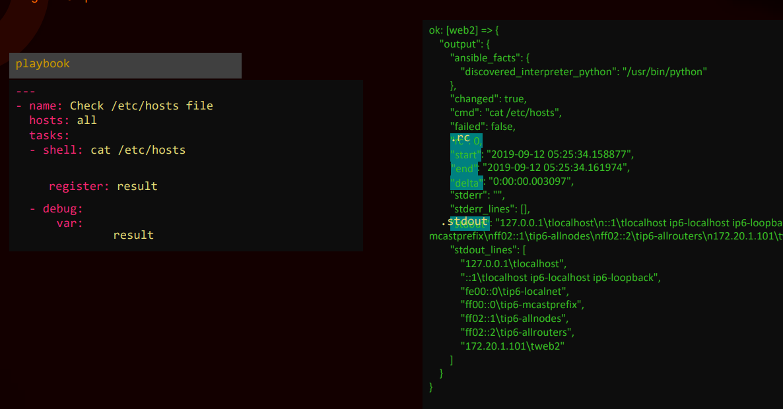
Ansible Variables – Registration

Slide 41
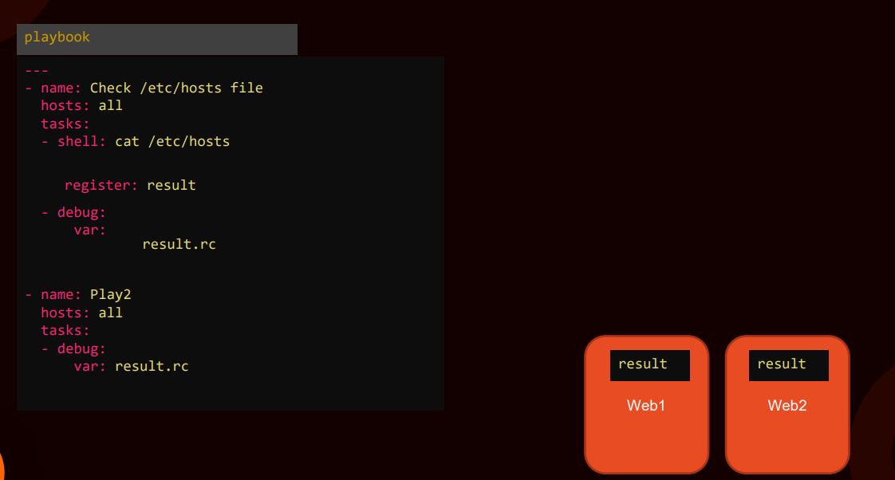
Ansible Variables – Registration

Slide 42
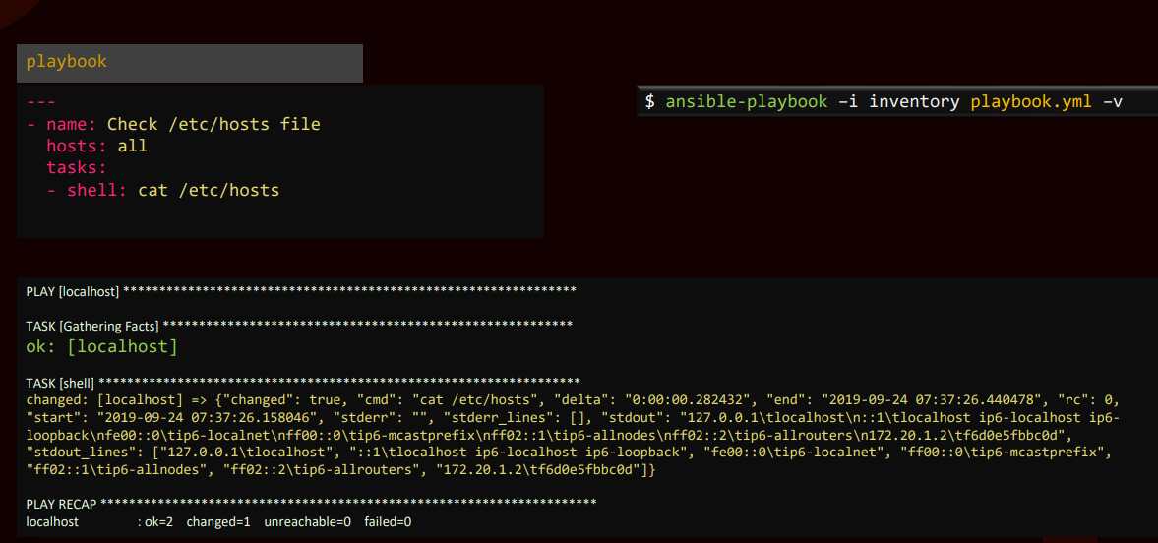
Ansible Variables – Registration

Slide 43
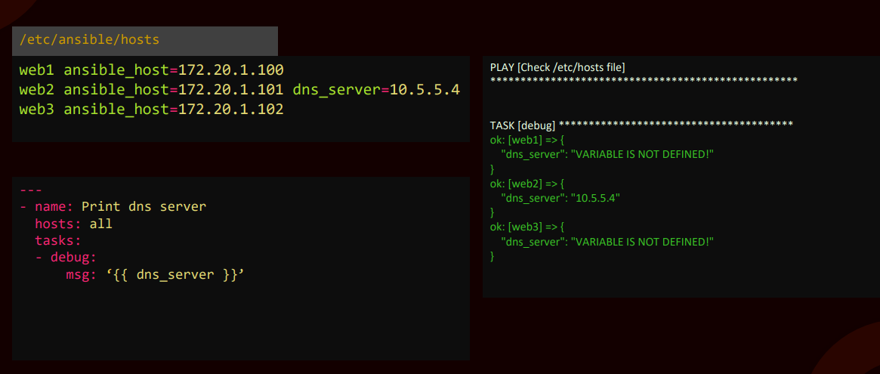
Ansible Variables – Scopes

Slide 44
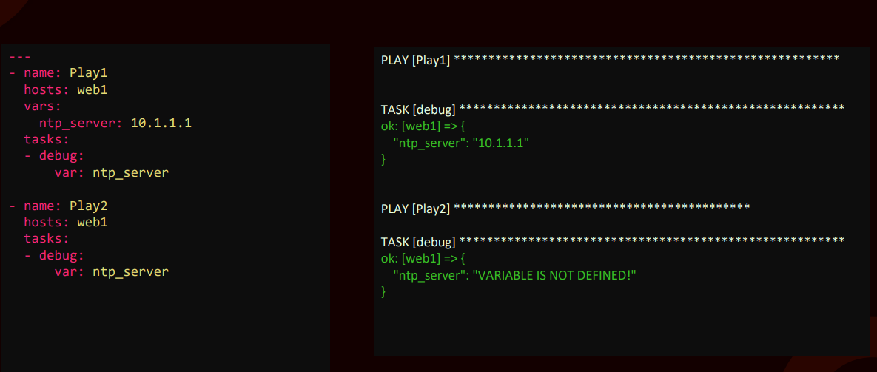
Ansible Variables – Scopes

Slide 45
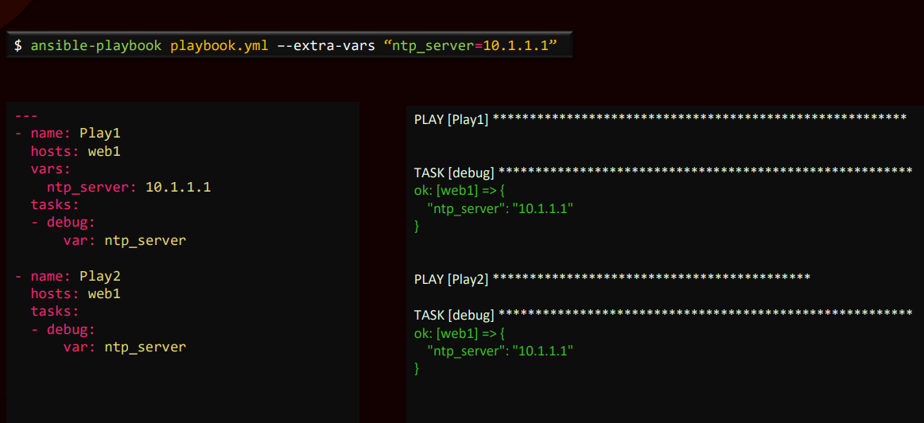
Ansible Variables – Scopes

Slide 46
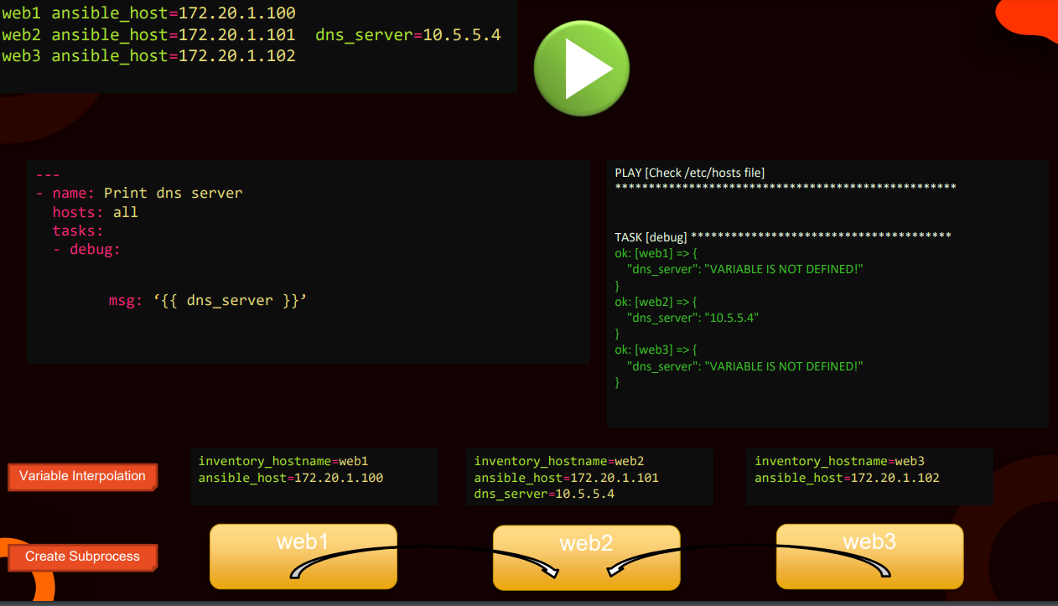
Ansible Magic Variables

Slide 47
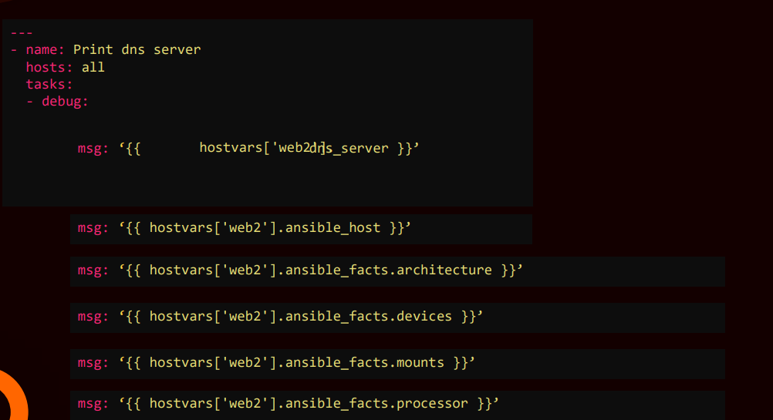
Ansible Magic Variables

Slide 48
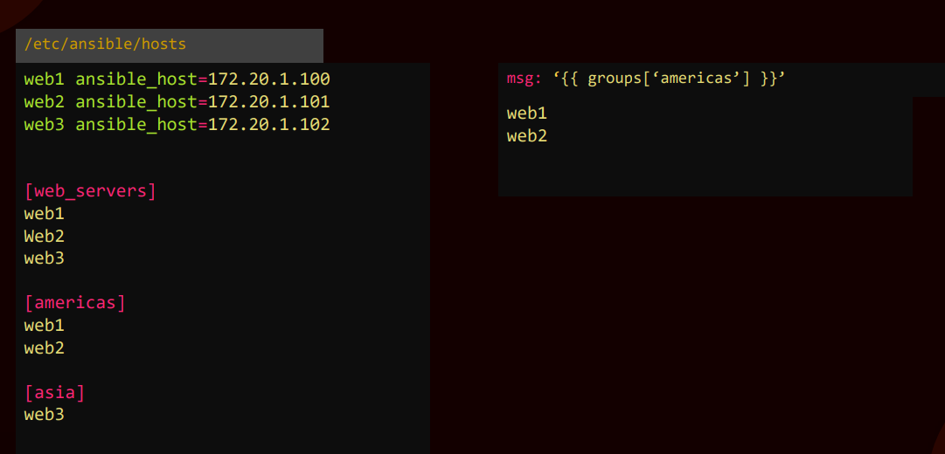
Ansible Magic Variables

Slide 49
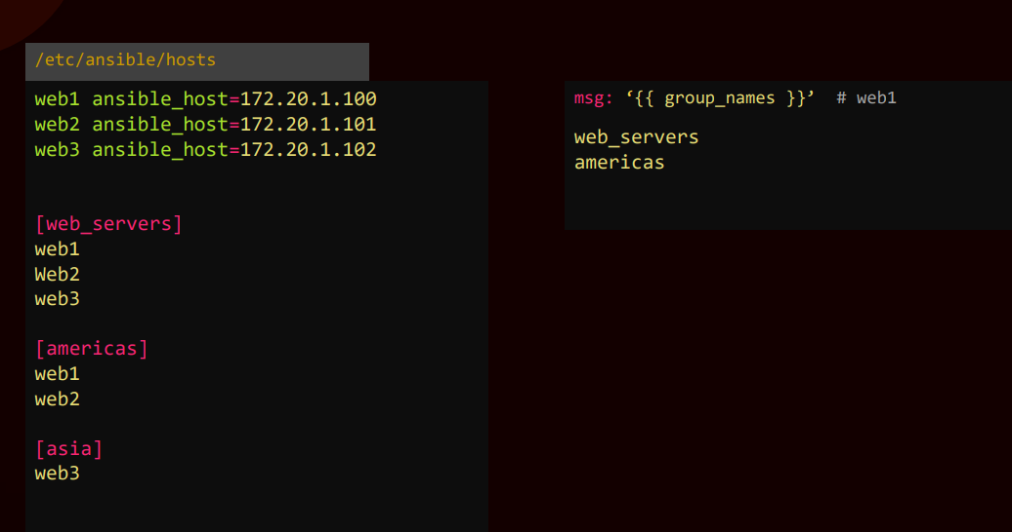
Ansible Magic Variables

Slide 50
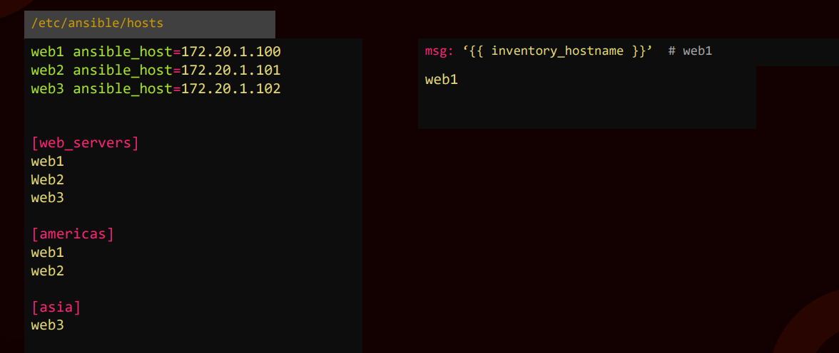
Ansible Magic Variables

Slide 51
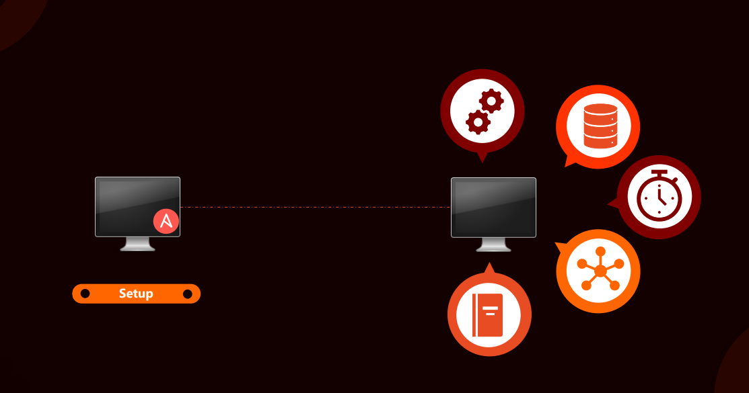
Ansible Facts

Slide 52
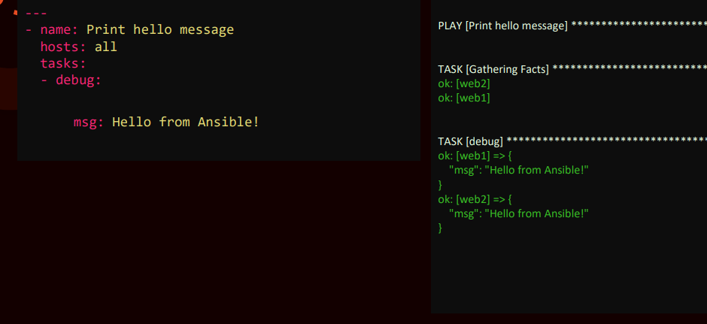
Ansible Facts

Slide 53
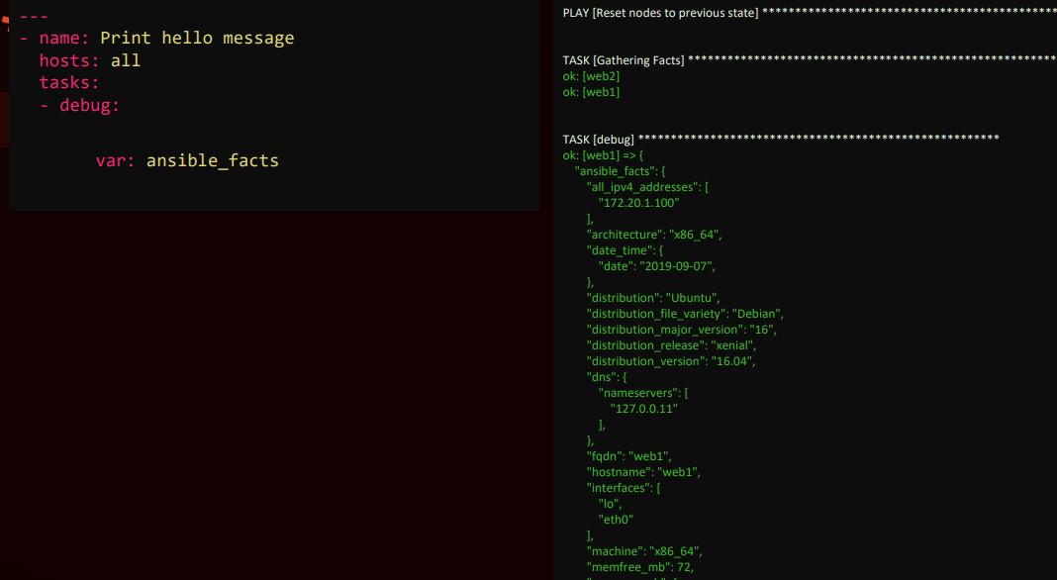
Ansible Facts

Slide 54
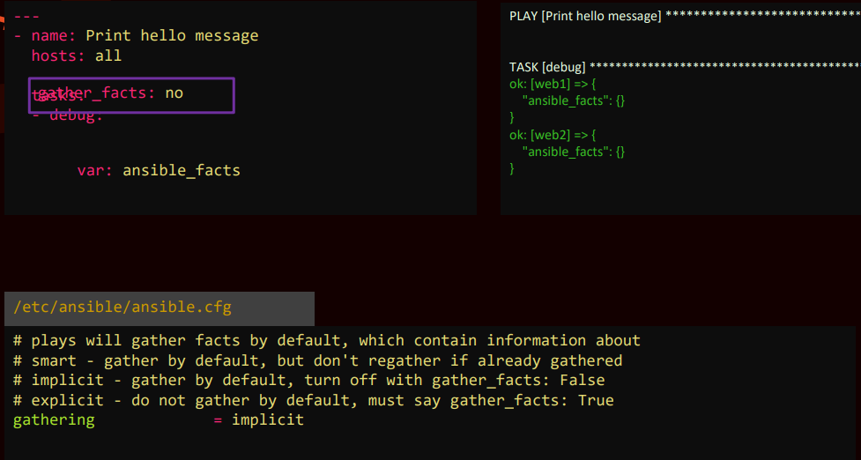
Ansible Facts

Slide 55

Ansible Playbooks

Slide 56

Ansible Playbooks

Slide 57

Ansible Playbooks

Slide 58

Ansible Playbooks

Slide 59

Ansible Playbooks

Slide 60

Ansible Playbooks

Slide 61

Verifying Playbooks

Slide 62

Verifying Playbooks

Slide 63

Verifying Playbooks

Slide 64

Verifying Playbooks

Slide 65


Verifying Playbooks

Slide 66

Verifying Playbooks

Slide 67


Verifying Playbooks

Slide 68

Verifying Playbooks

Slide 69

Ansible Conditionals

Slide 70

Ansible Conditionals

Slide 71

Ansible Conditionals

Slide 72

Ansible Conditionals

Slide 73

Ansible Conditionals

Slide 74

Ansible Conditionals

Slide 75

Ansible Conditionals on Facts

Slide 76

Ansible Loops

Slide 77

Ansible Loops

Slide 78

Ansible Loops

Slide 79

Ansible Loops

Slide 80

Ansible Loops

Slide 81

Ansible Modules

Slide 82

Ansible Modules

Slide 83

Ansible Modules

Slide 84

Ansible Modules

Slide 85

Ansible Modules

Slide 86

Ansible Modules

Slide 87

Ansible Plugins

Slide 88

Ansible Plugins

Slide 89

Ansible Plugins

Slide 90

Ansible Plugins

Slide 91

Ansible Plugins

Slide 92

Ansible Plugins

Slide 93

Ansible Plugins

Slide 94

Ansible Modules & Plugin Index

Slide 95

Ansible Modules & Plugin Index

Slide 96

Ansible Modules & Plugin Index

Slide 97

Ansible Modules & Plugin Index

Slide 98

Ansible Modules & Plugin Index

Slide 99

Ansible Handlers

Slide 100

Ansible Handlers

Slide 101

Ansible Handlers

Slide 102

Ansible Roles

Slide 103

Ansible Roles

Slide 104

Ansible Roles

Slide 105

Ansible Roles

Slide 106

Ansible Roles

Slide 107

Ansible Roles

Slide 108

Ansible Roles

Slide 109

Ansible Templating

Slide 110

Ansible Templating

Slide 111

Ansible Templating

Slide 112

Ansible Templating

Slide 113

Ansible Templating

Slide 114

Ansible Templating

Slide 115

Ansible Templating

Slide 116

Ansible Templating

Slide 117

Ansible Templating

Slide 118

Ansible Templating

Slide 119

Ansible Templating

